Slide 1
RAU Operating Systems 2015
Lab #1

Slide 2
Dedicated thread for async compute operations
To create a dedicated thread construct instance of System.Threading.Thread class.
public sealed class Thread : CriticalFinalizerObject, ... {
public Thread(ParameterizedThreadStart start); }
delegate void ParameterizedThreadStart(Object obj);
Demo: Create a thread to perform.
Notes:
Constructing a Thread object is a relatively lightweight operation because it does not actually create a physical operating system thread. To actually create the operating system thread and have it start executing the callback method, you must call Thread’s Start method, passing into it the object (state) that you want passed as the callback method’s argument
Notice the output may change from time to time.
Notice that the Main method calls Join. The Join method causes the calling thread to stop executing any code until the thread identified by dedicatedThread has destroyed itself or been terminated.

Slide 3
Dedicated thread for async compute operations (cont.)
Don’t use this technique ☺. Use ThreadPool class.
When to use a dedicated thread:
Non-normal thread priority. All thread pool threads run at normal priority. While you can change this, it is not recommended, and the priority change does not persist across thread pool operations.
You need the thread to behave as a foreground thread, thereby preventing the application from dying until the thread has completed its task. Thread pool threads are always background threads, and they may not complete their task if the CLR wants to terminate the process.
The compute-bound task is extremely long-running; this way, I would not be taxing the thread pool’s logic as it tries to figure out whether to create an additional thread.
You want to start a thread and possibly abort it prematurely by calling Thread’s Abort method
Notes:
Typically, you’d want to create a dedicated thread if you’re going to execute code that requires the thread to be in a particular state that is not normal for a thread pool thread

Slide 4
Reasons to use threads
There are really two reasons to use threads:
Responsiveness (typically for client-side GUI applications) Spawn some work off onto a thread so that your GUI thread remains responsive to user input events. In this example, you are possibly creating more threads than available cores on the machine, so you are wasting system resources and hurting performance. However, the user is gaining a responsive user interface and therefore having a better overall experience with your application.
Performance (for client and server side applications) Since Windows can schedule 1 thread per CPU and because the CPUs can execute these threads concurrently, your application can improve its performance by having multiple operations executing at the same time in parallel. Of course, you only get the improved performance if and only if your application is running on a machine with multiple CPUs in it.

Slide 5
Thread Priorities
A preemptive operating system: a thread can be stopped at any time and another thread can be scheduled using some kind of algorithm.
Every thread is assigned a priority level ranging from 0 (the lowest) to 31 (the highest)
Windows supports six process priority classes: Idle, Below Normal, Normal, Above Normal, High, and Realtime. Of course, Normal is the default.
Notes:
context structure reflects the state of the thread’s CPU registers when the thread last executed. After a time-slice, Windows looks at all the thread kernel objects currently in existence. Of these objects, only the threads that are not waiting for something are considered schedulable. Windows selects one of the schedulable thread kernel objects and context switches to it. Windows actually keeps a record of how many times each thread gets context switched to.
Windows schedules threads not process.

Slide 6
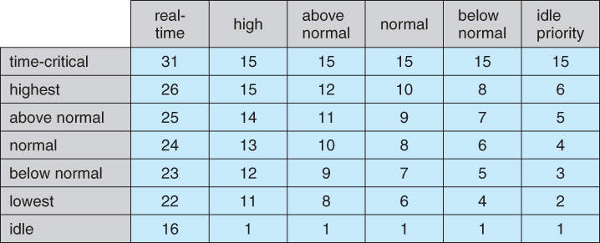
Thread Priorities (cont.)
Process and Thread priority relation
Notes:
You assign relative process priority.
Priority class set not value.
0 and some missing that’s for drivers.
Application can change thread priority by Threads' Priority property. Time critical and idle reserved for CLR.

Slide 7
Foreground and Background Threads
The CLR considers every thread to be either a foreground thread or a background thread. When all the foreground threads in a process stop running, the CLR forcibly ends any background threads that are still running. These background threads are ended immediately; no exception is thrown.
Demo. Foreground vs Background threads.

Slide 8
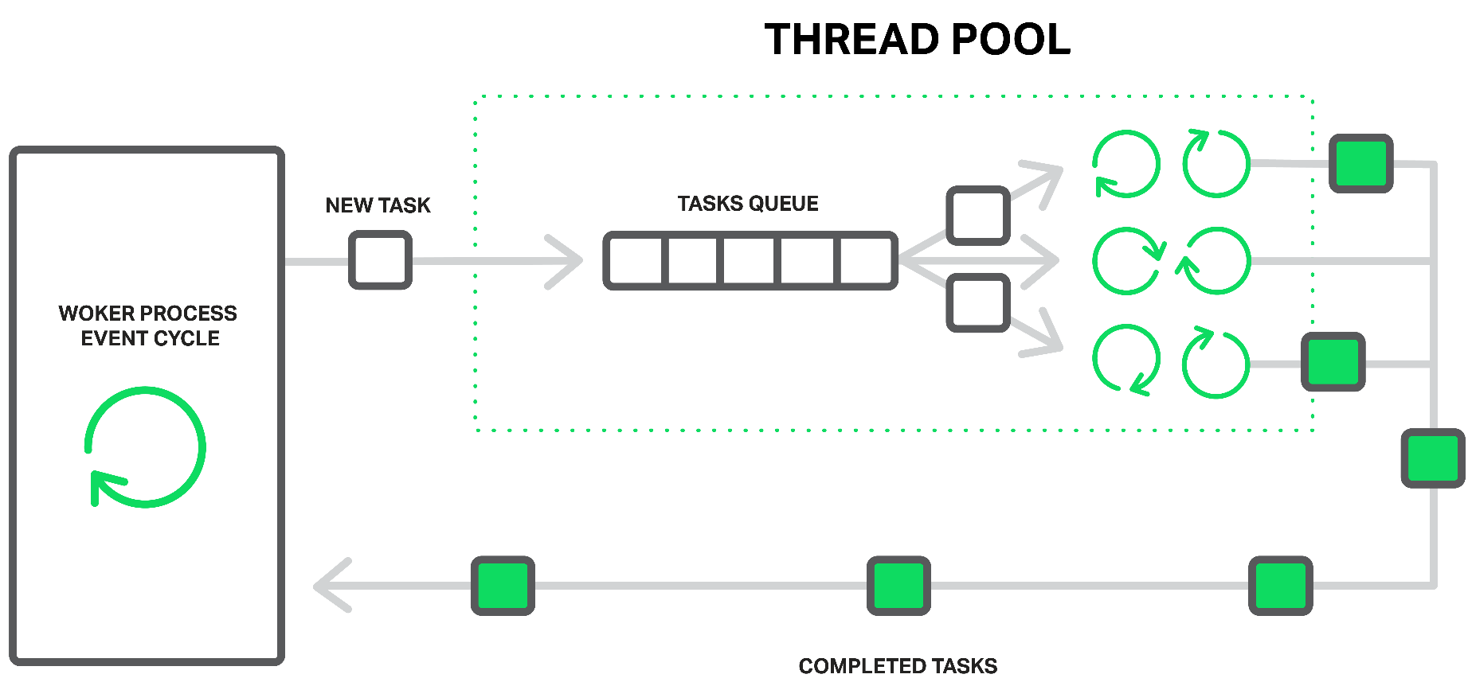
Thread Pools
Creating and destroying a thread is an expensive operation in terms of resources.
You can think of a thread pool as being a set of threads that are available for your application’s own use. There is one thread pool per CLR;

